Slide 1
QUANTITATIVE MORPHOMETRIC AND HYPSOMETRIC ANALYSIS USING RS AND GIS TECHNIQUES
Seminar on

Slide 2
Presented by,
VINAY K P
UMER ABDUR RAHMAN ROHITH R MANU K
VIII SEM, Dept. of Civil Engineering
PESCE Mandya. Under the Guidance of
Prof. R K KUMARASWAMY
Associate Professor
Dept. of Civil Engineering
PESCE Mandya

Slide 3
CONTENTS
Introduction
Scope of the work
Objectives
Literature review
Study area
Morphometric analysis
Hypsometric analysis
Result
Conclusions
References

Slide 4
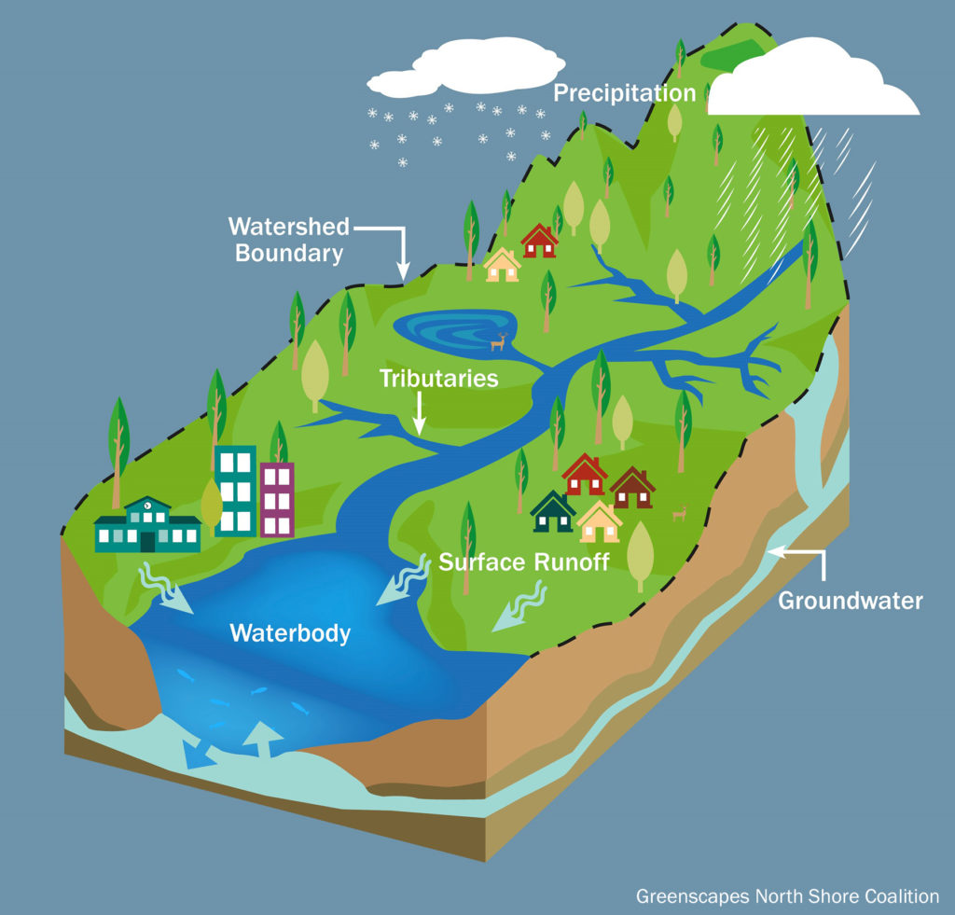
INTRODUCTION
Watershed is an area, which catches the water from precipitation and then is drained by a river and its tributaries.
Accurate delineation of a watershed plays an extremely important role in the management of the watershed.
watersheds are to be managed in an integrated sustainable manner, if not water resources and also other resources such as vegetation, fertile soil, fauna and flora get depleted.
The advantage offered by Remote Sensing data for Watershed development is its synoptic view, repetitive coverage and ability to acquire pictures beyond the visible region of the electromagnetic region.
GIS offers integration of spatial and non spatial data to understand and analyse the watershed processes.

Slide 5
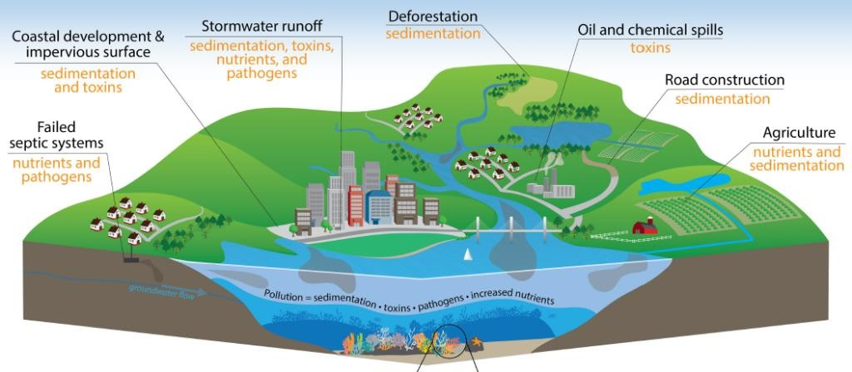
SCOPE OF THE PRESENT WORK
Based on the inferences obtained from morphometric analysis, effective management and conservation of natural resources in the study area can be determined.
The data utilize the resources for planning rainwater harvesting and watershed management.
The data set can be used for educational purposes, and for future research in watershed Morphometric studies.
The data shows the relationship occurring between the surface and subsurface of the groundwater.
Hypsometric analysis describes the elevation distribution across an area of land surface and its erosion stage in the study area.
Based on this analysis, importance in estimation of erosion status of watershed and subsequent prioritization for taking up soil and water conservation activities can be made.

Slide 6
LITERATURE REVIEW
DeepK. Kumaraswamy, Poornima, R. K & A. S. Ravikumar(2021).Quantitative Analysis of Morphometric and Hypsometric using RS and GIS Techniques .InternationalJournal of Engineering Research & Technology (IJERT) ISSN: 2278-0181 NCACE-EWIT- 2020 Conference Proceeding
Sak K et al., (2014) Carried out Morphometric analysis for prioritization using remote sensing and GIS techniques in a hilly catchment in the state of Uttarakhand, India. They concluded that Remote Sensing (RS) and Geographical Information System (GIS) techniques were used to update drainage and surface water bodies and to evaluate linear, relief and aerial morphometric parameters of the sub watersheds.
John Wilson J S et al., (2012) Worked for Morphometric analysis of major sub-watersheds in Aiyar and Karai Pottanar Basin, Central Tamil Nadu, India. They suggested that Morphometric analysis with the help of Geographic Information System (GIS) is most effective, time saving and accurate technique for prioritization, planning and management, site specific suitability of various soil and water conservation measures and development and management of ground water on watershed basis.

Slide 7
Kuldeep Pareta et al., (2011) Carried out research work on “Quantitative Morphometric Analysis of Watershed of Yamuna Basin, India, using ASTER (DEM) Data and GIS and found out obtaining synoptic view of large area through DEM at one time is very useful in analysing the drainage morphometry and (GIS) techniques helpful to assess the geo-hydrological characteristics. Also physiography of basin which is helpful for river water management, irrigation and site suitability for reservoirs.
Magesh et al., (2013) Carried out study on Geographical information system-based morphometric analysis of Bharathapuzha river basin, Kerala, India and suggested that the development of a drainage system over space and time is influenced by several variables such as geology, structural components, geomorphology, soil and vegetation of an area through which it flows.
Magesh N S et al., (2011) Carried out study on Morphometric evaluation of Papanasam and Manimuthar watersheds, parts of Western Ghats, Tirunelveli district, Tamil Nadu, India and concluded that Morphometric analysis of the watershed is considered to be the most satisfactory method because it enables (i) an understanding of the relationship of various aspects within a drainage basin (ii) a comparative evaluation to be made of different drainage basins developed in different geomorphological and topographical regimes and (iii) the definition of certain useful variables of drainage basins in numerical terms.

Slide 8
Nageswara Rao K et al., (2006), Carried out study on morphometry of the Mehadrigedda watershed, Visakhapatnam district, Andhra Pradesh, using GIS and RS data and found out that using traditional methods, it is difficult to examine all drainage networks from field observations. GIS technique as emerged as powerful tool for analysing the drainage morphometry.
Rekha et al.,(2011) Carried out study on Morphometric analysis and micro-watershed prioritization of Peruvanthanam sub-watershed, the Manimala River Basin, Kerala, South India and suggested that Integration of Remote Sensing (RS) and Geographical Information Systems (GIS) techniques are more convenient for morphometric analysis as compare to conventional method. It is a proven technique for delineating, updating and analysing the morphometric parameters of drainage basin and effective planning and management of natural resources is more suitable than other methods.

Slide 9
OBJECTIVE
Preparation of the different thematic maps using Survey of India (SOI) Topomaps of 1:50000 scale.
To derive the morphometric parameters such as linear, areal and relief aspects of the study area.
Morphometric analysis has been carried out by using Remote sensing (RS) and Geographic Information System (GIS) technology to compute basin morphometric characteristics for various parameters.
To draw the hypsometric curve.

Slide 10
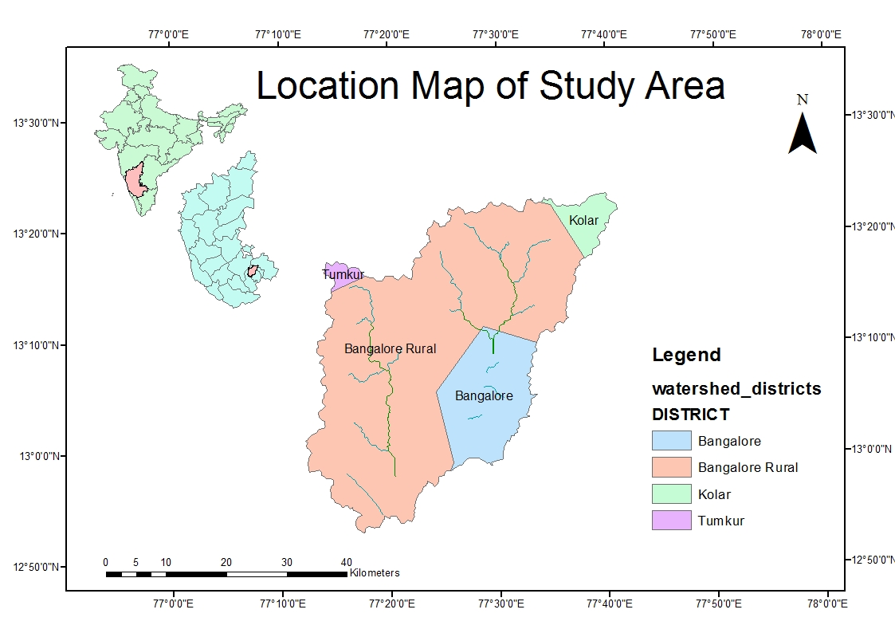
STUDY AREA and DATA PRODUCTS
Area selected: Manchanabele Reservoir
Ramnagar district , Karnataka.
Watershed: Manchanabele
Latitude : 12º 45’ 0” N and 13º 0’ 0” N
Longitude: 77º 50' 0” E and 77º 25’ 0” E
Elevation range: 1446m to 735m

Slide 11
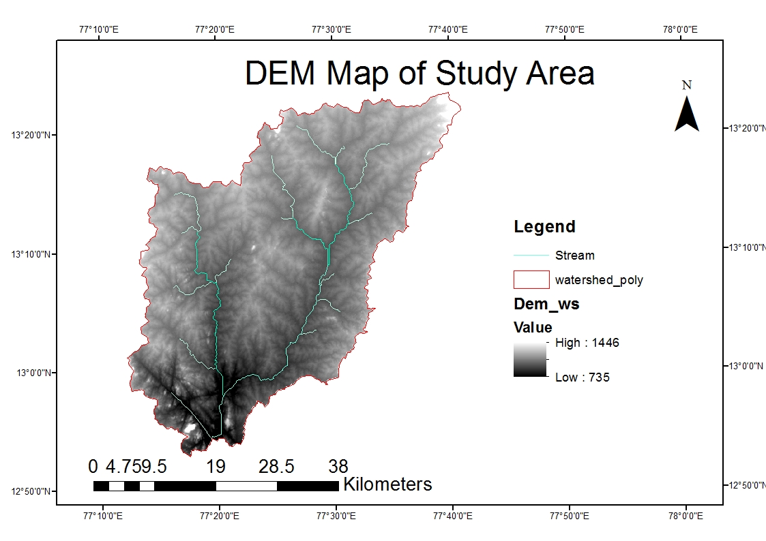
DIGITAL ELEVATION MODEL OF STUDY AREA
Manchanabele watershed, Area: 1594.54 km2, Perimeter: 243.66km

Slide 12
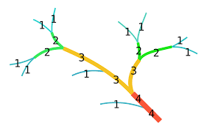
MORPHOMETRIC ANALYSIS
Morphometry is the measurement and mathematical analysis of the earth’s surface shape, and dimension of its Landforms.
It is a simple approach to describe watershed process and to compare watershed characteristics.
Morphometric techniques are applied for interpretation of salient features of drainage networks.
It incorporates a quantitative study of the area, its altitude, volume, profiles of land and the drainage basin characteristics of the concerned area.
Diagram showing the Strahler stream order

Slide 13
METHODOLOGY
DEM data is added to ArcGIS.
Basin and watersheds are delineated using DEM data.
The study area is clipped from the basin with Karnataka Boundary.
Generation of watershed terrain topology from DEM using ArcGIS
The results are inputs to calculate the morphometric parameters.

Slide 14
HYPSOMETRIC METHODOLOGY
Extraction of height and area from DEM data in Arc GIS software
HC have prepared by following Strahler percentage method
plotting the ratios ∆A/A (relative area)on X-axis and ∆E/E (relative elevation)on Y-axis
HI values are calculated using the equation, (Emean-Emin)/(Emax-Emin).
Based on HC and HI values watersheds are classified as old stage, mature stage and youth stage.

Slide 15
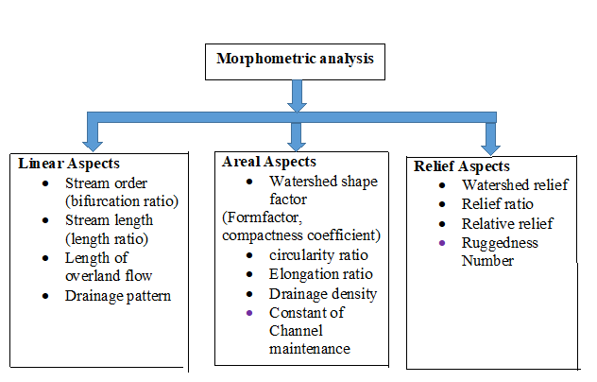
MORPHOMETRIC ANALYSIS
Morphometric analysis involves determining the
Linear aspects
Areal aspects
Relief aspects

Slide 16
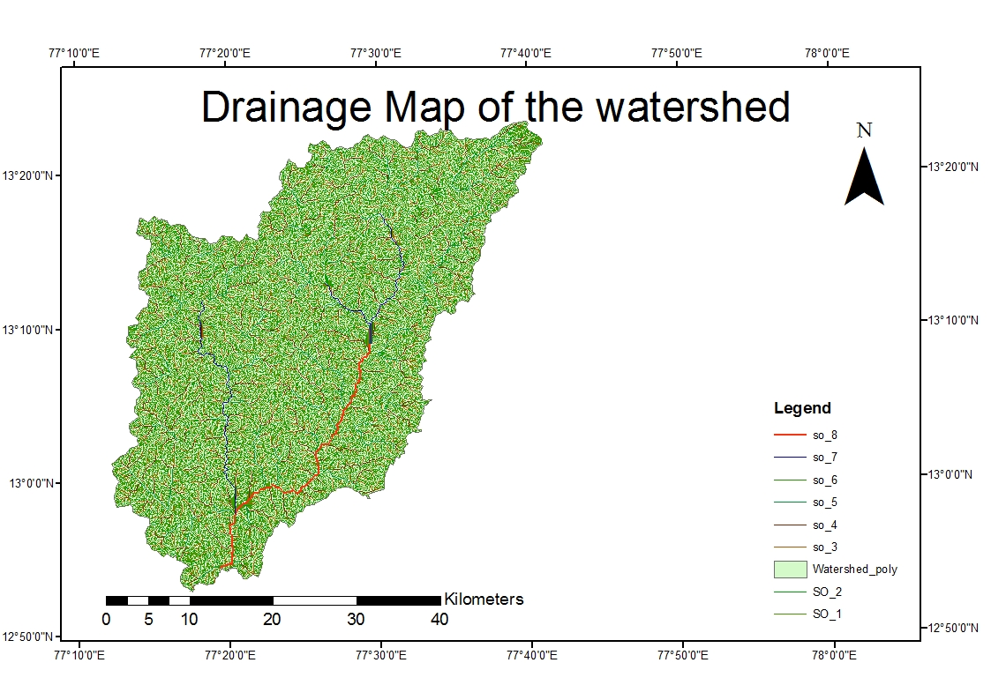
DRAINAGE MAP OF STUDY AREA

Slide 17
 | Morphometric Parameters | Formula | Reference
 | Stream order | Hierarchical rank | Strahler, 1964 [13]
LINEAR ASPECT |  | R_{b} = Nu / Nu+1 | Schumn,1956)[68]
 | Bifurcation ratio (R_{b}) | Where, Nu=Number of stream segments present in the given order, Nu+1= Number of segments of the next higher order
 | Stream length (Lu) | Length of the stream (km) | Horton, 1945[69]
 |  | L_{sm} = Lu / Nu, km | Horton, 1945)[69]
 | Mean stream length (Lsm) | Where, Lu=Mean stream length of a given order (km) Nu= Number of stream segments
 |  | D= (ΣLu /A ) km/km² | Horton, 1945) [69]
 | Drainage density (D_{d}) | Where, Lu=Total Stream length of all orders (km)
 |  | A=Area of the basin (km²)
AREAL ASPECT |  | S_{f} = Σ Nu /A | Horton, 1945) [69]
 | Stream frequency (S_{f}) | Where, Nu=Total number of streams in the basin
 |  | A= Basin area (km²)
 | Length of over land flow (Lo) | L_{o} = 1/ D_{d}×2 Km | Horton, 1945) [69]
 |  | Where, D_{d} = Drainage density (km/km²)
 |  | R_{f} = A / L² | Horton, 1945) [69]
 | Form factor (Rf) | Where, Au=Area of the basin (km2)
 |  | L=Maximum basin length (km)

Slide 18
R_{c} = 4πA/ P²
Miller, 1953[70]
Circularity ratio (Rc)
Where, A= Basin area ( km²), P= Perimeter of the basin (km), π = 3.14
AREAL ASPECT
Elongation ratio (Re)
Where, A= Area of the basin (km²), L=Maximum basin length (km) , π = 3.14
Schumn,1956[68]
Constant of channel maintenance
Where C= Constant of channel maintenance
Horton, 1945 [69]
D_{d} = Drainage density (km/km²)
H= (Difference in elevation of the highest _{Schumn,1956[68]}
Watershed relief (H)
point of watershed) - (Difference in elevation
of the watershed outlet)
RELIEF ASPECT
Where R_{h}= Relief ratio
Schumn,1956[68]
Relief ratio (R_{h})
Where H = Total catchment relief (km)
L = Maximum length of catchment (km)
H_{D}= H × D_{d}
Schumn,1956[69]
Ruggedness number (H_{D})
Where, H= Watershed relief, Dd= Drainage density

Slide 19
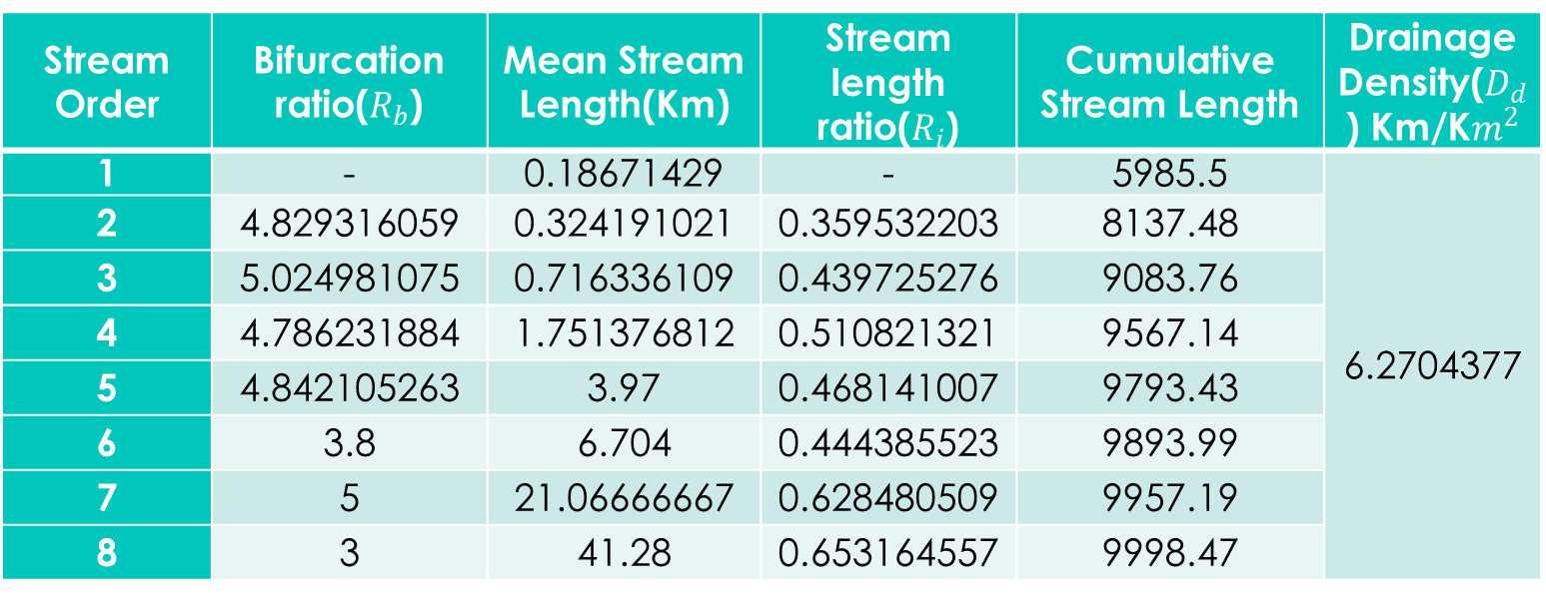
Linear aspects:
Linear aspects include the measurements of linear features of drainage such as stream order, stream length, stream length ratio, bifurcation ratio, length of overland flow and drainage pattern.
The allocation of the stream orders is based on a hierarchic ranking of streams.
Stream Order | Bifurcation ratio($R_{b}$) | Mean Stream Length(Km) | Stream length ratio($R_{i}$) | Cumulative Stream Length | Drainage Density($D_{d}$) Km/K$m^{2}$
1 | - | 0.18671429 | - | 5985.5 | 6.2704377
2 | 4.829316059 | 0.324191021 | 0.359532203 | 8137.48
3 | 5.024981075 | 0.716336109 | 0.439725276 | 9083.76
4 | 4.786231884 | 1.751376812 | 0.510821321 | 9567.14
5 | 4.842105263 | 3.97 | 0.468141007 | 9793.43
6 | 3.8 | 6.704 | 0.444385523 | 9893.99
7 | 5 | 21.06666667 | 0.628480509 | 9957.19
8 | 3 | 41.28 | 0.653164557 | 9998.47

Slide 20
Graph of stream length vs. stream order

Slide 21
Graph of No of stream vs. stream order

Slide 22
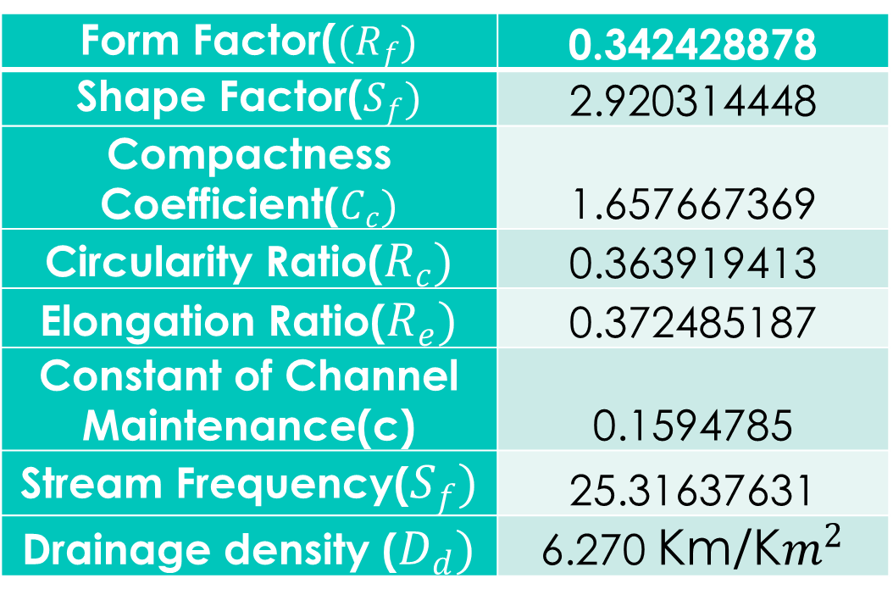
Areal aspects:
Area of a watershed (A) and perimeter (P) are the important parameters in quantitative morphology.
The area of the watershed is defined as the total area projected upon a horizontal plane contributing to cumulate of all order of watersheds.
Form Factor($(R_{f})$ | 0.342428878
Shape Factor($S_{f})$ | 2.920314448
Compactness Coefficient($C_{c})$ | 1.657667369
Circularity Ratio($R_{c})$ | 0.363919413
Elongation Ratio($R_{e})$ | 0.372485187
Constant of Channel Maintenance(c) | 0.1594785
Stream Frequency($S_{f})$ | 25.31637631
Drainage density ($D_{d})$ | 6.270 Km/K$m^{2}$

Slide 23
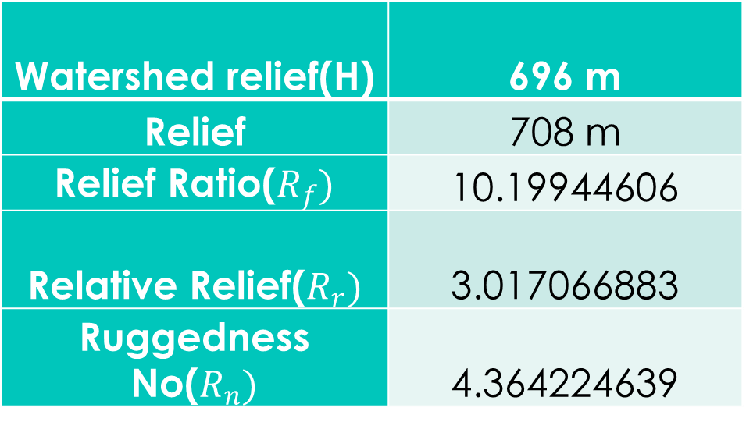
Relief aspects:
Relief aspects of drainage basin relate to the three dimensional features of the basin involving area, volume and altitude.
It is used to analyze terrain characteristics.
Relief is the elevation difference between the highest and lowest point on the valley floor of the region.
Relief aspects is an indicator of flow direction of water.
Watershed relief(H) | 696 m
Relief | 708 m
Relief Ratio($R_{f})$ | 10.19944606
Relative Relief($R_{r})$ | 3.017066883
Ruggedness No($R_{n})$ | 4.364224639

Slide 24
INFERENCES
The watershed has dendritic drainage pattern.
Stream order:
The Manchanabele sub-basin consists of 8th order stream covering an area of 1594.54 km2.
Stream length
Generally, the total length of stream segments decreases as the stream order increases .
The stream length obtained is 9998.47 km

Slide 25
Calculation of stream order, length of stream, mean of stream
Sl. No | Stream Order | Count | Length(km) | Mean
1 | 1 | 32057 | 5985.5 | 0.1867
2 | 2 | 6638 | 2151.98 | 0.3241
3 | 3 | 1321 | 946.28 | 0.7163
4 | 4 | 276 | 483.38 | 1.7513
5 | 5 | 57 | 226.29 | 3.9701
6 | 6 | 15 | 100.56 | 6.7045
7 | 7 | 3 | 63.2 | 21.065
8 | 8 | 1 | 41.28 | 41.286

Slide 26
Stream frequency (Fs):
Stream frequency value for watersheds Values of Fs in the study
area is 25.31 streams/km2
for basin. High Fs indicates that the basin has a rocky surface and
low permeability.
Stream Frequency | No. streams/Sq.km
Low | 0-5
Moderate | 5-10
Moderate high | 10-15
High | 15-20
Very high | 20-25
(Source: Horton and Strahler 1964)

Slide 27
Elongation Ratio (R_{e}):
The values of Re obtained for the sub-basin is 0.37 which indicates that the basin is more elongated.
Watershed Shape | Ratio
Circular | 0.9
Oval | 0.8-0.9
Less elongated | 0.7-0.8
Elongated | 0.5-0.7
More elongated | 0.5
(Source: Horton and Strahler 1964)

Slide 28
Form factor (R_{f})
The value of Rf obtained is 0.34 which Indicates the soil is most susceptible to Erosion.
Flood flows of such elongated watersheds are easier to manage than from the circular watersheds.
Circularity Ratio (Rc)
The Rc values obtained is 0.36 . The value ranges from 0.2 to 0.5, greater the value more is the circularity ratio.

Slide 29
Drainage density (Dd)
Drainage density of the basin is 6.27 km/km² .
These high values of drainage density infers watersheds are very fine textured.
Low permeable subsoil material with high relief.
Infiltration rate is less and have less water potential.
Drainage density (Km/km²) | Textures
< 1.24 | Very coarse
1.24-2.49 | Coarse
2.49-3.73 | Moderate
3.73-4.97 | Fine
> 4.97 | Very fine

Slide 30
Shape Factor (Bs)
The sediment and runoff-production rates, drainage length and roughness are influenced
by Bs. Thus, in terms of Soil Erosion response, Bs behaves like Rf. Among the sub-basins,
the lowest Bs value (2.92) and therefore the highest erodibility is observed in Manchanabele
sub-basin.

Slide 31
HYPSOMETRIC ANALYSIS
Hypsometric analysis is a useful method to identify the stage reached by a drainage basin in the present cycle of erosion and evaluate the erosional status of a basin and also expresses the denudation processes over a region.
It expresses the overall slope and forms of drainage basin.
It explains erosion state of watershed that had taken place during the geological time scale due to hydrologic processes and land degradation factors
HI is an indicator of the stages of “cycle of erosion” and considering this fact, HI is calculated and classified,
HI ≤ 0.3 indicates old stage,
HI ≥0.3 to ≤0.6 indicates mature stage and
HI ≥0.6 indicates youth stage (highly erosion prone).

Slide 32
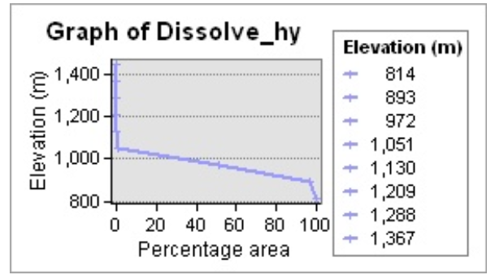
HYPSOMETRIC CURVE
A curve showing the relationship of area to elevation for specified terrain
The shape of hypsometric curve represents the geomorphic stages of landform evolution.
Convex shape indicates younger, dissected, disequilibrium landscapes stage
smooth S-shape shows mature or equilibrium stage
concave shape curve is related to an old deeply dissected stage.

Slide 33
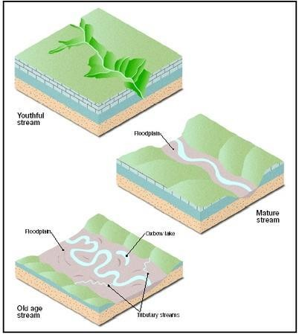
STAGES OF DEVELOPMENT
MATURE STAGE
Not as steep banks
Small floodplain
Slight meanders
Moderate flow
Moderate erosion
YOUNG STAGE
Steep banks
No floodplain
Straight path
Fastest flow
Heavy erosion
OLD STAGE
Gently sloping banks
Large floodplain
Large meanders
Slowest flow
Little or no erosion

Slide 34
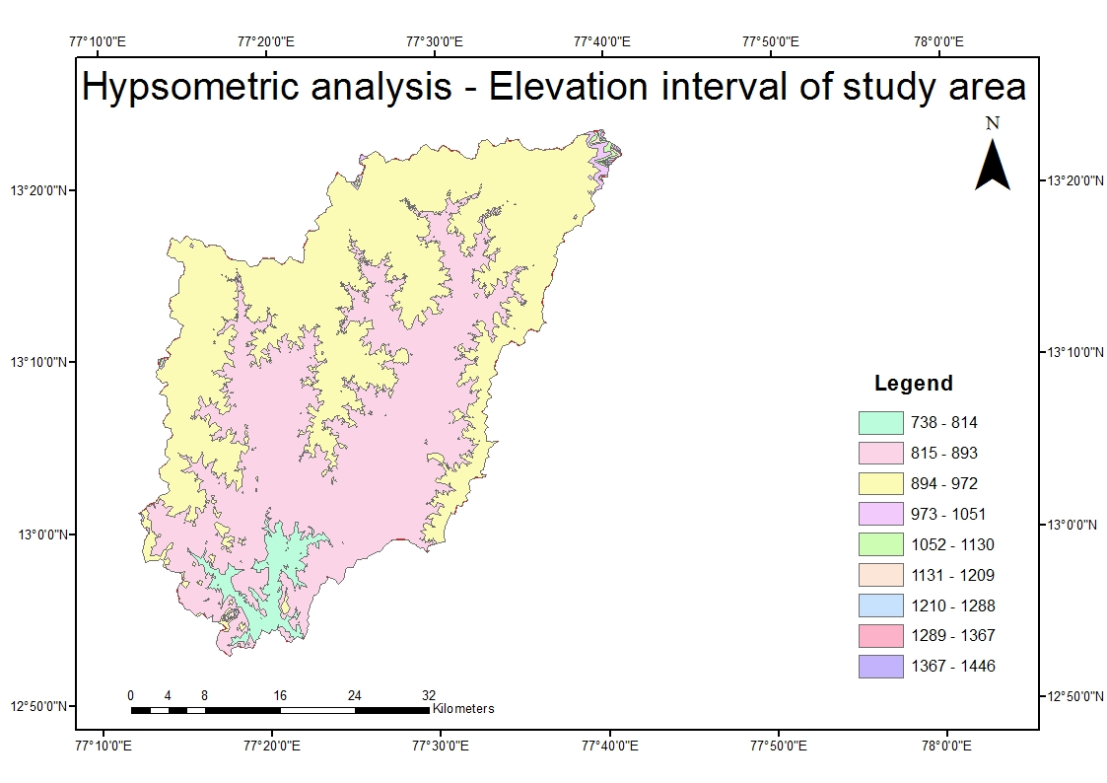
ELEVATION INTERVAL MAP OF MANCHANABELE SUB BASIN

Slide 35
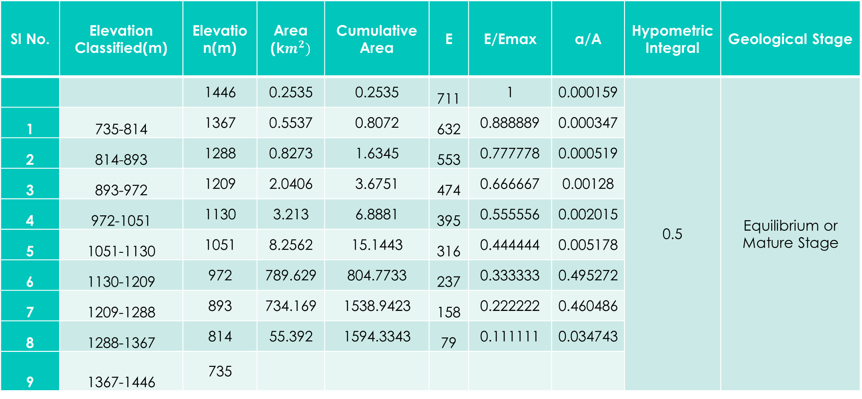
HYPSOMETRIC ANALYSIS CALCULATIONS TABLE
Sl No. | Elevation Classified(m) | Elevation(m) | Area (k$m^{2})$ | Cumulative Area | E | E/Emax | a/A | Hypometric Integral | Geological Stage
 |  | 1446 | 0.2535 | 0.2535 | 711 | 1 | 0.000159 | 0.5 | Equilibrium or Mature Stage
1 | 735-814 | 1367 | 0.5537 | 0.8072 | 632 | 0.888889 | 0.000347
2 | 814-893 | 1288 | 0.8273 | 1.6345 | 553 | 0.777778 | 0.000519
3 | 893-972 | 1209 | 2.0406 | 3.6751 | 474 | 0.666667 | 0.00128
4 | 972-1051 | 1130 | 3.213 | 6.8881 | 395 | 0.555556 | 0.002015
5 | 1051-1130 | 1051 | 8.2562 | 15.1443 | 316 | 0.444444 | 0.005178
6 | 1130-1209 | 972 | 789.629 | 804.7733 | 237 | 0.333333 | 0.495272
7 | 1209-1288 | 893 | 734.169 | 1538.9423 | 158 | 0.222222 | 0.460486
8 | 1288-1367 | 814 | 55.392 | 1594.3343 | 79 | 0.111111 | 0.034743
9 | 1367-1446 | 735

Slide 36
INFERENCE
The HI values obtained is 0.5 which represents Late Mature stage or Equilibrium.

Slide 37
CONCLUSIONS
From the above discussion following conclusions can be drawn.
The length of overland flow in the Manchanabele reservoir catchment in the present study is more than 3.135. Hence, the Reservoir catchments selected for study have longer flow paths associated with less infiltration and more Runoff. Overland flow (3.13km) is high runoff will be more infiltration is less .By mixing the sand with the soil we can increase its infiltration capacity and ground water potential.
Analyzed morphometric parameters such as area, length, stream pattern, flow direction, and perimeters all these are reflect the shape and topography of the given watershed.
Drainage density (6.27km/km2) and stream frequency (25.31No/km) is high thus we can divert the stream which will provide for irrigation purpose.
Elongation ratio (0.37) ,circulatory ratio (0.36),form factor(0.34) , shape factor(2.92) which indicate that the watershed is more elongated thus its maintenance and utilization of watershed is easy.

Slide 38
CONCLUSIONS CONTD…
The results of morphometric analysis provide information about catchment development on priority basis and areas vulnerable for land degradation.
It is found that drainage density of 6.2704km/km² was indicated that the basin is not much affected by structural disturbance and indicates the very fine texture of the watershed.
In the areas of higher drainage density the infiltration is less and surface runoff is more.
The higher value of stream frequency is observed in Manchanabele catchment and Manchanabele catchment indicates low conducting subsurface material, sparse vegetation and high relief.
The higher value of form factor in Manchanabele catchment indicates wider basin and lower value of form factor in Manchanabele catchment indicates narrow basin.
Hypsometric Curve from hypsometric analysis clearly shows that the watershed is equilibrium at mature stage.
Hypsometric integral value obtained is 0.5 which shows that the watershed is in mature stage and it is moving towards old stage it turn erosion will decrease and water holding capacity will increase.

Slide 39
REFERENCES
Alaya, M. B., Saidi, S., Zemni, T., & Zargouni, F. (2014). Suitability assessment of deep groundwater for drinking and irrigation use in the Djeffara aquifers (Northern Gabes, south-eastern Tunisia). Environmental Earth Sciences, 71, 3387–3421.
Anitha, P., Charmaine, J., & Nagaraja, S. (2011). Evaluation of groundwater quality in and around Peenya industrial area of Bangalore, South India using GIS techniques. Environmental Monitoring and Assessment.
Gnanachandrasamy, G., Ramkumar, T., Venkatramanan, S., Anitha Mary, I., & Vasudevan, S. (2012). GIS based hydro geochemical characteristics of groundwater quality in Nagapattinam district, Tamilnadu, India. Carpathian Journal Earth and Environmental Sciences, 7(3), 205–210.
Horton, R. E. (1945). Erosional development of streams and their drainage basins. Hydro physical approach to quantitative morphology. Geological Society of America Bulletin, 56, pp.275-370.
Horton, R. E. (1945). Erosional development of streams and their drainage basins. Hydrophysical approach to quantitative morphology. Geological Society of America Bulletin, 56, pp.275-370.

Slide 40
REFERENCES CONTD…
KuldeepPareta and UpasanaPareta (2011).Quantitative Morphometric Analysis of a Watershed of Yamuna Basin, India using ASTER (DEM) Data and GIS. International journal of Geomatics and Geo- sciences, vol.2 (1), pp.248-269.
Kumar, S. K., Rammohan, V., Sahayam, J. D., & Jeevanandam, M. (2009). Assessment of groundwater quality and hydro geochemistry of Manimuktha River basin, Tamil Nadu, India. Environmental Monitoring and Assessment, 159, 341– 351
Langbein,(1947). Topographic characteristics of drainage basins,U.S.G.S. Water Supply Paper. 968C: pp.127-157.
Miller, V.C. (1953). A quantitative geomorphic study of drainage basin characteristics in the Clinch Mountain area. Virginia and Tennessee. Proj. NR 389-402, Tech. Rep 3, Columbia University, Department of Geology, ONR, New York.
Perth Amboy, New Jersey. Geological Society of America, Bulletin, 67: pp597-646.
Sameena, M., Krishnamurthy.J. Jayaraman.V. and Ranganna, G. (2009) Evaluation of drainage networks developed in hard rock terrain: Go-carto International pp1-24.

